Slide 1
Welcome to the Grapevine Mustang Band
2016-2017
grapevinehsband.com

Slide 2
Instructional Staff/ Design Team-Marching Band
Shannon Gill - Dir. of Bands shannon.gill@gcisd.net
Barry Janicula - Associate Dir. of Bands barry.janicula@gcisd.net
Stephen Segura - Associate Dir. of Bands stephen.segura@gcisd.net
Michael Henson - Dance Guard Director jmhenson2010@gmail.com
Andrew Seebaran - Dance Guard Asst. Dir. iamseebaran@yahoo.com
Manny Maldonado - Music Arranger
Andy Toth - Design Consultant
Pending - Front Ensemble Technician/ Battery Technician/Visual technicians

Slide 3
Marching Band/Concert Band = BAND
Spring/Summer
Fall Schedule
Spring Schedule
4/23 - Hype Day at GHS 9am-1pm
4/25 - Concert Band Auditions at your campus-assign concert band
Summer Music Days - at least 3 for those that are in town.
Band Camp - July 27-Aug.19 Pre-Register!
Weekly Rehearsals:
During class and After School
After School:
Mon., Thurs. - 4:15-6:15pm
Tues. - 4:45-7:15pm at MPS*
Wed. - 4:15-5:30pm
Games on Friday. If we have a Thurs. Game, we will hold the practice on Friday. This schedule will run until competitive season is over. (9 weeks)
Contest and Game schedule on calendar on the website
*Depending on MPS availability
During Class
4 Bands - WE,HB,SB, CB
Sectionals for each student once a week, approx. 1 hour in preparation for UIL Concert/Sightreading contest
solo/ensemble contest, band trip, banquet, May concert

Slide 4
Marching Band Frequently Asked Questions
Can I take Band and Athletics/Theater/Choir/Debate/Swimming/Cross Country, etc.?
We welcome and encourage you to take Band along with another area of interest during your freshman year. The gap between 8th and 9th grade year is not a time to make a decision about your long-term future. It’s important to see what the high school programs have to offer. Once you’ve seen how these activities function and are taught/coached, you will have a much clearer picture of how your high school years will be defined. Scheduling issues can be worked out. All Elective teachers work very well together to ensure a student can participate in more than one activity.
I
Do I have to take P.E. if I am in Band?
No. Marching Band provides a P.E.credit
Can I participate in band for only half of the school year?
No. We require all band students to participate fully in both marching band and concert band unless extremely extenuating circumstances arise.
Please speak to a GHS band director for more information.

Slide 5
Can I take advanced classes and Band?
Most AP and Pre-AP are full of band students. It’s difficult for students to manage taking 8 92 minute lecture classes (A/B schedule) all-day, everyday. We recommend band as a creative break in the day - a chance to flex your creative muscle and a time to build your musical abilities (and your resume). The Grapevine Band consistently has students in the top 10% of their class and has often times has National Merit Scholars. Band also helps students master the very necessary skill of Time Management!
What do double reed players do during marching season?
Double reed players can choose to audition for the Dance Guard or make a seasonal change to a new instrument. Common changes are to percussion or saxophone.
What if I don’t own an instrument?
Mr. Janicula will be contacting the Middle Schools in the Spring semester to inform you of our instrument check out dates. We have a limited number of upper woodwind instruments but have quite a few of the other instrument groups. Once school starts, the school district charges $50 per semester per instrument to rent from it. This cost covers repair and maintenance as well as suffices as a rental fee.

Slide 6
What is the structure of the band?
Wind Ensemble = Band Varsity = Periods 1 and 5
Honors Band = Band Non-Varsity = Periods 2 and 6
Symphonic Band = Band Non-Varsity A = Period 3
Concert Band = Band Non-Varsity B = Period 7
Dance Guard = Band Guard/Dance Guard = Periods 3 and 7
Drumline Class = Band Percussion = Periods 4 and 8 (Fall only)
A student’s placement is determined by tryouts in the Spring. During the fall semester
(marching season) all of these parts meet together for rehearsals after
School. During the school day each member will rehearse with their assigned group
during their assigned class period.
In the spring each group will meet during their assigned class time the difference being that
percussion students will now meet with their assigned band instead of as a percussion class.
What is Dance Guard?
The Dance Guard is an integral part of the visual performance of the marching show. Selection is
based on tryouts in the spring. The group is under the direction of the Dance Guard Director.
The Guard augments the marching show by incorporating dance and equipment (flags, rifles, and a variety of props).
The Dance Guard has their own individual competition season in the second semester called
Winter Guard. Contact Mr. Henson for more details

Slide 7
What is Summer Band Camp?
The beginning of August marks the start of Marching Season. It is all about learning the band’s
marching show-music and drill. Attendance at this camp is mandatory. Speak to the directors about any concerns.
Generally, the schedule is:
July 25-26- Band Leadership team workdays 8am-5pm
July 27-28 - Freshman only camp 8am-3pm with a lunch from 11:30-12:30
July 29 - All Band Students 8am - 3pm with a lunch from 11:30-12:30
First 2 weeks of Aug. (Aug.1-12) - Monday –Friday 8:00 a.m. – 5:00 p.m. with a lunch break from 11:30 – 1:00.
Third week of Aug. (Aug.15-19) – 5:00 p.m. – 8:00 p.m. (Dance Guard schedule may vary)
Things to know:
The kids must wear a hat, sunglasses, and sunscreen.
They also must bring a large water jug. (Freshman will receive a half gallon jug at band fair)
Tennis shoes are required
Light colored clothes are encouraged
Students may bring their lunch or leave campus with parent permission.
Do I have to attend Summer Band Camp?
Yes. If you are registered for band, you must attend summer band camp.

Slide 8
Does every band member march in the show?
Yes! The competitive marching shows are designed for a specific number of band members and dance guard members. This number is somewhat less than the number of members in the band. The competitive marching spots will be assigned by the directors during summer band camp after they have had the opportunity to watch the students march and listen to them play. The members who are not assigned a marching spot in our competitive show will be designated to our Spirit Line. These students are allowed to challenge for a marching spot. They must know the spot that they are challenging and have their music pass offs done. The challenge process continues until school begins. Then spots are locked down. Students in the Spirit line are given drill and will march at every football game half time, play in the stands at the games, attend all pep rallies and parades and any other function of the Mustang Band. These students will have the opportunity to develop their playing and marching skills through our daily rehearsals and are given the same instruction from our high quality teachers as those in the competitive marching show. Students in the Spirit line will march their drill at football game halftime performances and as we get closer to our first contest, will be utilized to handle props on the field ,when props are part of the show, and/or play another role to enhance the visual aspect of the show. Students in the competitive show will be expected to know all of the music or guard work for the show and will be assigned a position on the field they will be expected learn. When a member can’t march because he/she is ill, he/she becomes ineligible because of low grades, or for any
other reason, a director may use a student from the Spirit LIne to replace him/her on the field. This happens quite often. Students in the Spirit LIne are expected to be at every rehearsal and band function.

Slide 9
What is Band Fair? (This year on Saturday, July 30th)
It is a chance for the PARENTS to get all of the information they will need to navigate through
the band year. This is when all paperwork must be completed..
Stations will be set up so you can learn about fundraising opportunities, sign up for
Volunteer opportunities, sign up to chaperone, order formal wear for the spring concert season,
purchase spirit wear and so much more.
Is attending the Band Fair important?
YES! It is Mandatory - at least one parent needs to attend with the student. This is the only time our representative from Totes will be available to size students for marching shoes (which you purchase) and concert wear like tux shirts and bow ties (also purchased by parents of boys). It is also where you can purchase the required polo shirt (additional cost), pick up your water jug and band show theme t-shirt. (included - no additional cost).
Is there a fee for Band?
Yes
The school district only covers the cost of UIL activities and their marching uniform. This means football
games and 1-2 UIL marching competitions. The band competes in approximately 3-4 other marching competitions each season. Fees cover clinicians, master classes, the cost of the marching show, music arrangement (including copyright fees), drill, visual design, Dance Guard design, drill techs, all instructors other than Band Directors,contest entry fees, transportation costs to competitions, parades, and other non-UIL events,snacks and meals while at contests, meals for away games, water jugs, show theme t-shirts, and many other items and services that combine to fund this competitive program for our students.
The previous year’s cost per member was $425. We do anticipate an increase in fees this year, except for Dance Guard. (extra charge for costume still applies). Payment plan provided throughout the summer.

Slide 10
Is there an opportunity to fundraise and have the proceeds apply to my band fee and/or trip costs?
Yes, many! We are fortunate to have a fundraising coordinator who has worked tirelessly to provide not only fundraisers that benefit the band program as a whole, but also many opportunities for students to raise funds to help reduce their band fee and/or their trip fee.
We have had many fundraising opportunities on a monthly basis.
More information to come from
Uma Benzick - ghsbanddollars@gmail.com

Slide 11
Where can I find more information?
More information about the band, including policies on grading and attendance, is in the Grapevine High School Band Handbook. This can be found online at www.grapevinehsband.com (password - Mustang_Pride)
For calendar information, visit http://www.grapevinehsband.com/calendar.html
For the Dance Guard website:
http://www.grapevineguard.com
Percussion specific information on website - students - percussion
Don’t forget to pre-register for the 2016 Grapevine HS Mustang Band!
www.grapevinehsband.com - on the home page - Pre-Registration Form

Slide 12
Charms
We use Charms as a data management tool for the band. Frequent mass emails are sent through Charms. Please make sure your data is current. 8th graders will be “promoted” to 9th grade once the school year is over. All data moves over with them.

Slide 13
Grapevine High School Band Boosters
Vice-President Pam O’Quinn pgoquinn@gmail.com
Fundraising/Corporate Sponsor Coordinator Uma Benzick ghsbanddollars@gmail.com
The GCISD Band Booster organization operates as a single organization for the benefit of all the band students in GCISD grades 6-12. Each campus has an elected group of band booster parents to tend to the specific needs of that campus. The GHS Band could not operate without the help and support of these parent volunteers. Parents are needed to fill many volunteer spots.

Slide 14
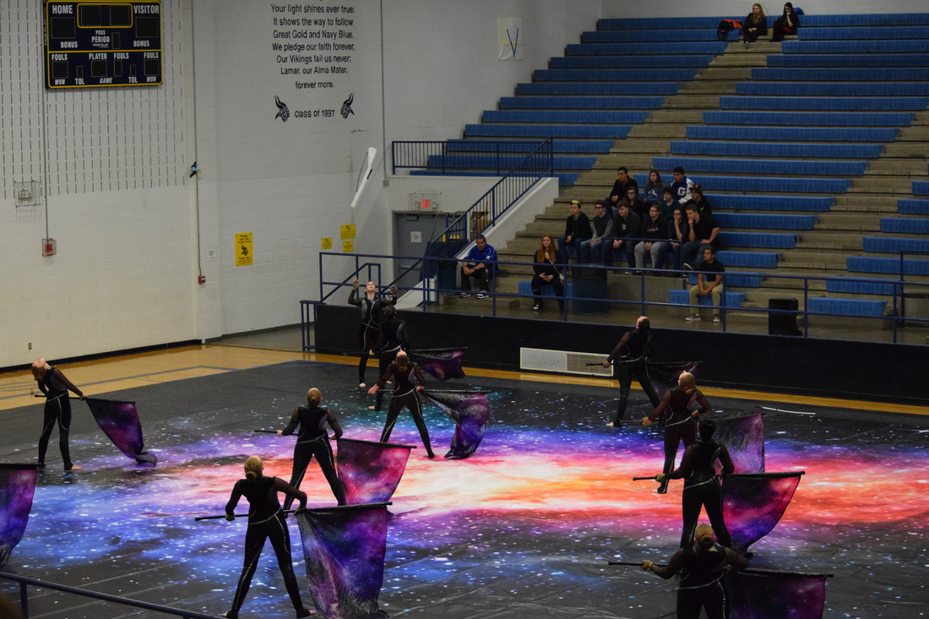
Grapevine High School Dance Guard
Director: Mr. Michael Henson - jmhenson2010@gmail.com

